Slide 2
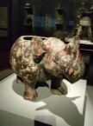
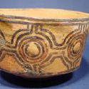
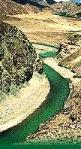
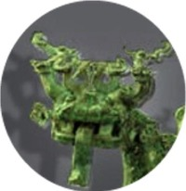
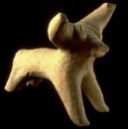
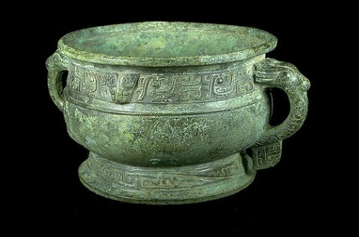
Chapter 3: Early Civilizations in India and China
Part 1: India

Slide 3
Geography of the Indian Subcontinent
Mountains in the north limited contact- helped India to develop a distinct culture
The subcontinent is divided into three major zones:
Northern plain- well watered, fertile region, 3 major rivers (Indus, Ganges, Brahmaputra), highly populated
Deccan Plateau- dry, unproductive, sparsely populated
Coastal Area- heavy seasonal rains, mountains, fishing

Slide 4
The rivers of India, particularly the Ganges, are considered sacred.
The monsoons, or seasonal winds, are a defining feature of Indian life.
Monsoons bring needed rain, but timing and amount matter.

Slide 5
Indus Valley Civilization

Slide 6
Indus Valley Civilization
Early Indian civilization flourished for about 1,000 years, then vanished without a trace.
Archaeologists have only recently begun to uncover evidence of these early people.

Slide 7
Characteristics of the Indus Valley Civilization:
Well-organized government
Modern plumbing and sewer system
Carefully planned cities-grid pattern
Most people were farmers
First people to cultivate cotton
Covered largest area of any civilization at the time
Started to trade with distant lands
Polytheistic; honored mother goddess; worship of sacred animals influenced the later veneration of cattle

Slide 8
Decline and Disappearance of Indus Valley Civilization
No one knows for certain why the cities were abandoned and forgotten. Some theories include:
-Too many trees were cut down.
-A devastating earthquake destroyed the region.
-A volcanic eruption caused the Indus to flood the city.
-Aryan invaders overran the region.

Slide 9
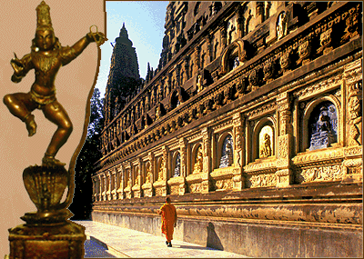
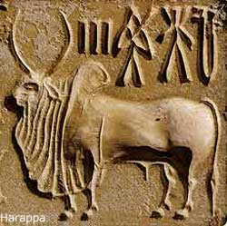
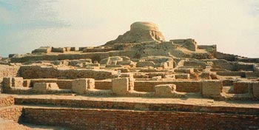
Kingdoms of the Ganges

Slide 10
Aryan Invasion
Most likely the Aryans destroyed and looted
the civilization of the Indus Valley, they:
Were nomadic warriors
Built no cities and left no statues
Felt superior to the people they conquered
Were Polytheistic
Religious teachings from the Vedas
People born into castes, or social groups, which they could not change.

Slide 11
Early Class System in Aryan Society
Brahmins
priests
Kshatriyas
warriors & royals
Vaisyas
farmers, merchants, craftsmen
Sudras
servants, laborers

Slide 12
Aryan Civilization
Expansion led to change in Aryan civilization because
they:
-mingled with the people they conquered
-gave up their nomadic ways and settled into villages to farm and breed cattle
-fought to control trade and territory
-some rajas, or tribal chiefs, became hereditary rulers
-developed the written language of Sanskrit

Slide 13
Epic Literature
Two great epic poems tell us about Aryan
life and values:
The Mahabharata celebrates battle and reflects important Indian beliefs about the immortality of the soul.
The Ramayana celebrates a daring and adventurous hero and portrays the ideal woman as loyal and obedient to her husband.

Slide 15
Hinduism
Hinduism grew out of many varied beliefs of different peoples who settled in India.
There was no single founder of Hinduism.
Polytheistic- many gods and goddesses and many forms of worship.
Development of the caste system came from Hinduism.

Slide 16
The Basic Beliefs:
Dharma- religious and moral duties all Hindus believe in, how you live day to day.
Karma- all the actions of a person’s life that affect his or her fate in the next life.

Slide 17
Moksha- free yourself from selfish desires to achieve union with brahman, the end of reincarnation
Reincarnation- allows people to continue working toward moksha through several lifetimes.

Slide 18
How they worship:
Spiritual cleansing everyday (many in the Ganges)
Worship at personal shrines
Practice yoga and meditation
Veneration of cattle
Study sacred texts: Vedas and Upanishads

Slide 19
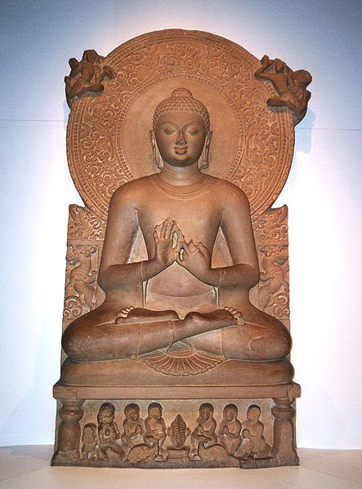
Buddhism

Slide 21
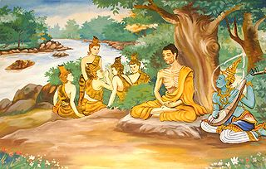
Siddhartha Gautama founded the religion of Buddhism.
He was born around 566 B.C. to a high-caste family- left his family to find answers about life
For 48 days he meditated and fasted until he understood the mystery of life
He emerged as
“Buddha”,
the awakened one

Slide 22
Teachings of Buddha
Four Noble Truths -
(the heart of Buddhism)
All life is full of suffering, pain, and sorrow
The cause of suffering is the desire for things that are illusions (riches, power, long life)
The only cure for suffering is to overcome desire
The way to overcome desire is to follow the Eightfold Path
***SEE HANDOUT

Slide 23
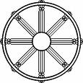
The Eightfold Path
Eightfold Path, a middle road between a life devoted to pleasure and a life of harsh self-denial.
***See Handout

Slide 24
More Teachings
Live a moral life of- honesty, charity, kindness to all living creatures and to avoid evil words and actions.
Enlightenment is achieved through
meditation.
The ultimate goal is nirvana, union
with the universe and release from the
cycle of rebirth.

Slide 25
Spread of Buddhism

Slide 26
Followers accompanied the Buddha as he preached across Northern India.
Some Buddhists set up monasteries and convents that grew into centers of learning.
Missionaries and traders spread Buddhism across India to many parts of Asia.

Slide 27
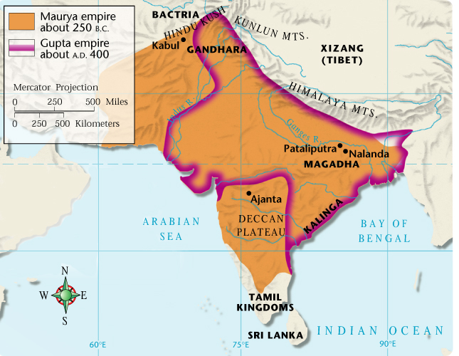
Powerful Empires of India

Slide 28
Maurya Emperors
Chandrgupta was the first powerful Maurya ruler, conquering vast amounts of land.
His grandson, Asoka fought a
long, bloody war to conquer
the Deccan plateau, 10,000
people were slaughtered.
Asoka then converted to Buddhism, rejecting violence and living a moral life.

Slide 29
Maurya Empire
Maurya rulers:
supervised the building of roads and harbors.
collected taxes.
created royal court systems.
created a secret police force to report on corruption, crime, and dissent.

Slide 30
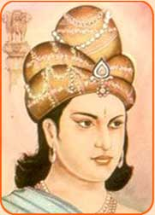
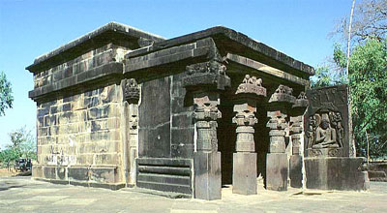
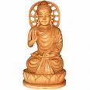

Slide 31
Kingdoms of the Deccan
People had many different languages and traditions. Left rich and diverse literature.
Each kingdom had its own capital and magnificent temples.
Rulers were tolerant of all religions and foreign settlers, improved harbors for trade with the Roman Empire and China.
Women enjoyed high status and economic power.

Slide 32
The Golden Age of the Gupta’s
2
India experienced a Golden age or a period of great cultural achievements during the rule of the Gupta.
A golden age is marked by a time of peace and prosperity.

Slide 33
A period of great achievement
Medicine- doctors treated illnesses with herbs, performed surgery, set broken bones, vaccinated against smallpox
Math- invented a system of numbers we use today, decimal system, concept of zero

Slide 34
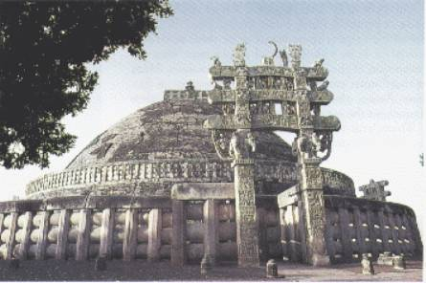
Architecture- designed stone temples and dome-shaped shrines called stupas.
Carving & Painting- artists painted murals and carvings telling the story of the life of Buddha.

Slide 35
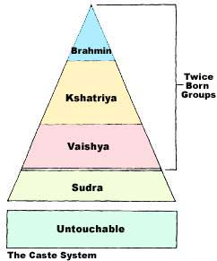
The Caste System and Daily Life
Caste rules governed every aspect of life and became more restricted–where people lived, what they ate, how they dressed, and what work they did.
Life for the lowest ranking caste, the
“Untouchables,” was harsh and
restricted.
Each caste had its own leaders and
caste members cooperated to help one
another.

Slide 36
Family Life in India
The ideal was the joint family, in which extended family all lived under one roof.
The family was patriarchal. The father or oldest male had absolute authority.
Family wishes came before individual wishes.
Early on, children learned family duties, such as obedience of caste rules.
Parents had a duty to arrange good marriages for their children, based on caste and family interests.
The status and freedom of women decreased over time. A woman’s duties were to marry, obey her husband, and raise children.

Slide 37
Village Life in India
Economics-
Villages were self-sufficient, producing most of the food and goods needed.
Sometimes villagers traded at regional markets.
Politics-
Each village ran its own government with little interference as long as taxes were paid to the empire.
A village council made decisions.

Slide 38
Chapter 3: Early Civilizations in India and China
Part 2: China

Slide 39
The Geography of China
China was the most isolated of the civilizations.
Long distances and physical barriers (mountains, desert, jungle, ocean) separated China from Egypt, the Middle East, and India.

Slide 40
Isolation contributed to the Chinese belief that China was the center of the earth and was the only civilization.
Ethnocentrism- Belief in the superiority of one's own ethnic group.
Chinese civilization began in a river valley, the Huang He. (Yellow River).

Slide 41
The Dynastic Cycle in China
Promoted idea of Mandate of Heaven- gods decide who would rule.

Slide 43
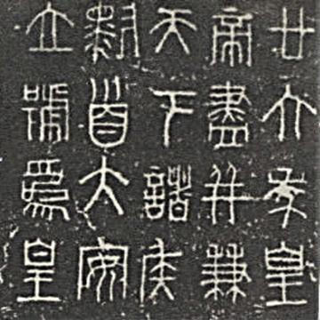
Shang Dynasty (1650 B.C.–1027 B.C.)
Controlled corner of northern China along Huang He River.
Held complex religious beliefs. Beliefs of Yin and Yang.
Developed written
language used by all
Chinese people.

Slide 44
Zhou Dynasty (1027 B.C.–256 B.C.)
Set up feudal state- lords governed their own lands, owed military service and other support to the ruler.
Economy and commerce grew- use of money, ironworking, new crops.
Population increased

Slide 45
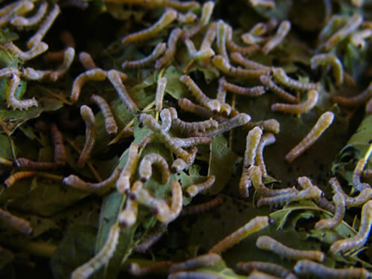
Cultural Achievements of Shang & Zhou:
Made silk thread-a most valuable product.
Made the first books from wood and bamboo.
Studied the movement of planets and recorded
eclipses of the sun.
Developed accurate calendar with 365 1/4 days.
Made remarkable achievements in the art of
bronze making.

Slide 46
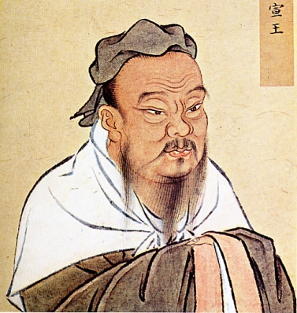
Philosophy and Religion in China
The Wisdom of Confucius

Slide 47
Teachings of Confucius
Confucius developed a philosophy that was concerned
with how to ensure social order and good government. His
ideas included:
Harmony results when people accept their place in society.
Everyone has duties and responsibilities. Filial piety, or
respect for parents, is the most important duty.
A ruler has the responsibility to provide good government. Government leaders and officials should be well educated.

Slide 48
Five Relationships
Confucius stressed five key relationships:
Father over son
Elder brother over younger brother
Husband over wife
Ruler over subject
Friend to friend

Slide 49
Legalism
Legalism was another philosophy created to achieve order in society.
The only way to achieve order is to pass strict laws and impose harsh punishments on lawbreakers.
The ruler alone possesses power.

Slide 50
Daoism
Laozi founded Daoism in an effort to live in harmony with nature, not to bring order to society.
Government is unnatural and is the cause of many problems.
The best government is the one that governs the least.

Slide 51
Buddhism in China
Buddhism became popular among the Chinese. It
was appealing because it:
promised an escape from suffering
offered hope of eternal happiness
presented Buddha as a compassionate, merciful god
taught that anyone could gain salvation through prayer, good works, and devotion

Slide 52
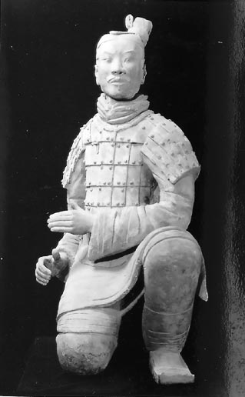
The Qin Dynasty
Emperor Shi Huangdi

Slide 53
How did Shi Huangdi unite China?
He:
had military districts governed by loyal officials.
spies reported on his officials.
forced noble families to live in his capital so he could monitor them.
jailed, tortured, and killed those who opposed his rule.
had all books of philosophy and literature burned.
standardized weights and measures.
created uniformity in Chinese writing.
strengthened the transportation system.
ordered the building of the Great Wall & Terra Cotta Soldiers.

Slide 54
Though his methods were brutal, Shi Huangdi ushered in China’s classical age during the Qin Dynasty.
Called a classical age because it set patterns in government, philosophy, religion, science, and the arts that served as the framework for later cultures.

Slide 55
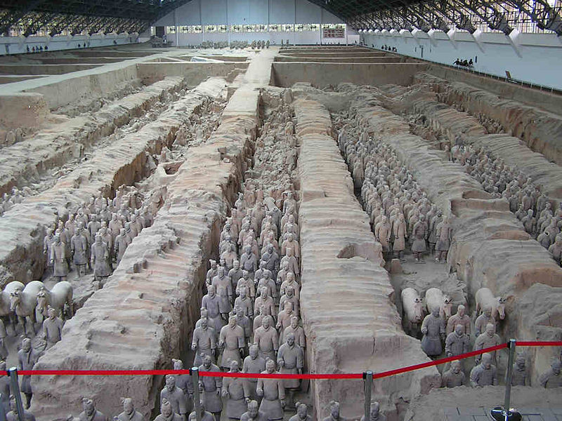

Slide 56
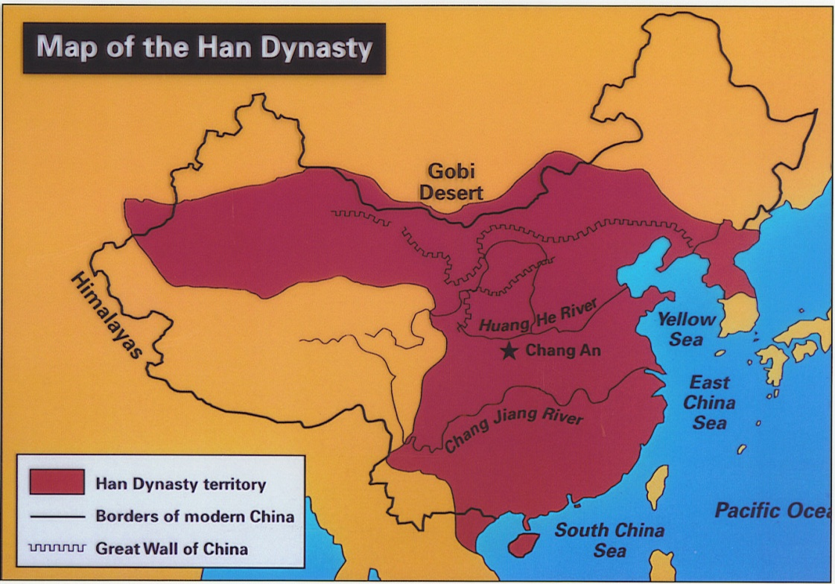
Han Dynasty
A new dynasty took over after the death of Emperor Qin. The Han Dynasty gained control after many years of war.
Han rulers wanted to continue to unify China.
Han rulers wanted
to ease the harsh
conditions that
people lived under.

Slide 57
Economic Improvements:
Built more canals and roads
Set up granaries across the empire
Imposed a government monopoly on iron and salt
Increase trade with western civilizations using the Silk Road

Slide 58
Government Improvements:
Made Confucianism the official belief of the state
Relied on well-educated
scholars to run the
government
Used a civil service exam to find the most qualified officials

Slide 59
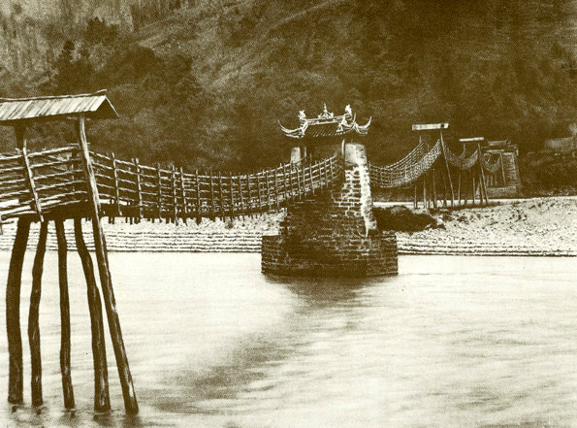
The Han Golden Age
Science:
Wrote texts on chemistry, zoology, and botany
Invented seismograph to measure earthquakes
Technology:
Made paper out of wood pulp
Pioneered advanced methods of shipbuilding
Invented the rudder,
fishing reels, wheelbarrows,
and suspension bridges

Slide 60
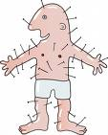
Medicine:
Diagnosed diseases
Developed anesthetics
Explored uses of acupuncture
Arts:
Built grand temples and palaces
Produced jade and ivory carvings and ceramic figures
Improved bronze working and silk making techniques

