Slide 1
The Industrial revolution
Know | Want to Know | Learned

Slide 2
SWBAT explain the importance of changes brought about by the industrial revolution.
The Industrial Revolution

Slide 3
Write down KEY POINTS
http://www.history.com/topics/industrial-revolution/videos/the-industrial-revolition

Slide 4
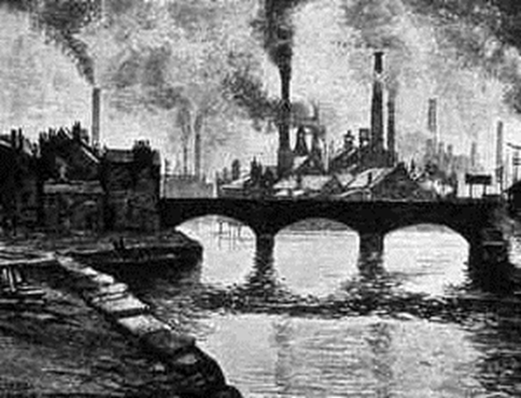
Define “Industrial Revolution”
Based on the video we watched, write a 1 sentence definition of the Industrial Revolution.

Slide 5
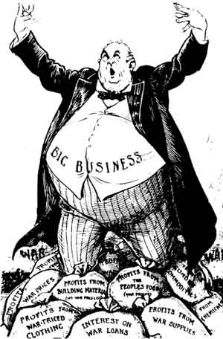
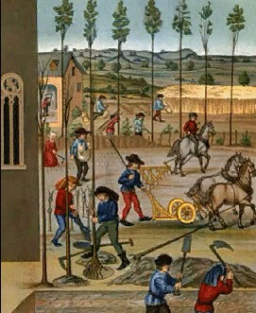
Critical Thinking
How does this new system, capitalism, differ from the medieval system of feudalism?

Slide 6
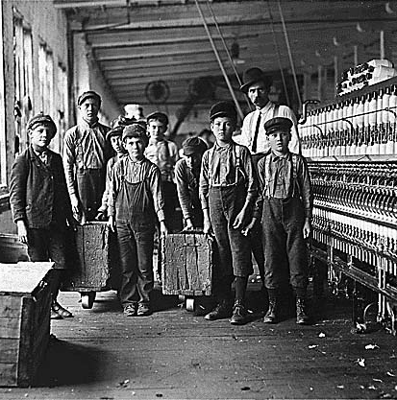
Causes of the Industrial Revolution
1. Population Growth
  Childhood survival

Slide 7
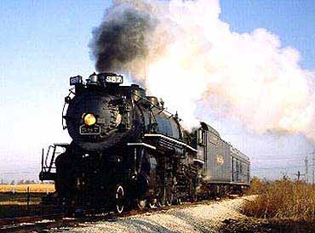
Causes of the Industrial Revolution
2. New technology
(Thank you Scientific Revolution. LOL. Owe you one.)

Slide 8
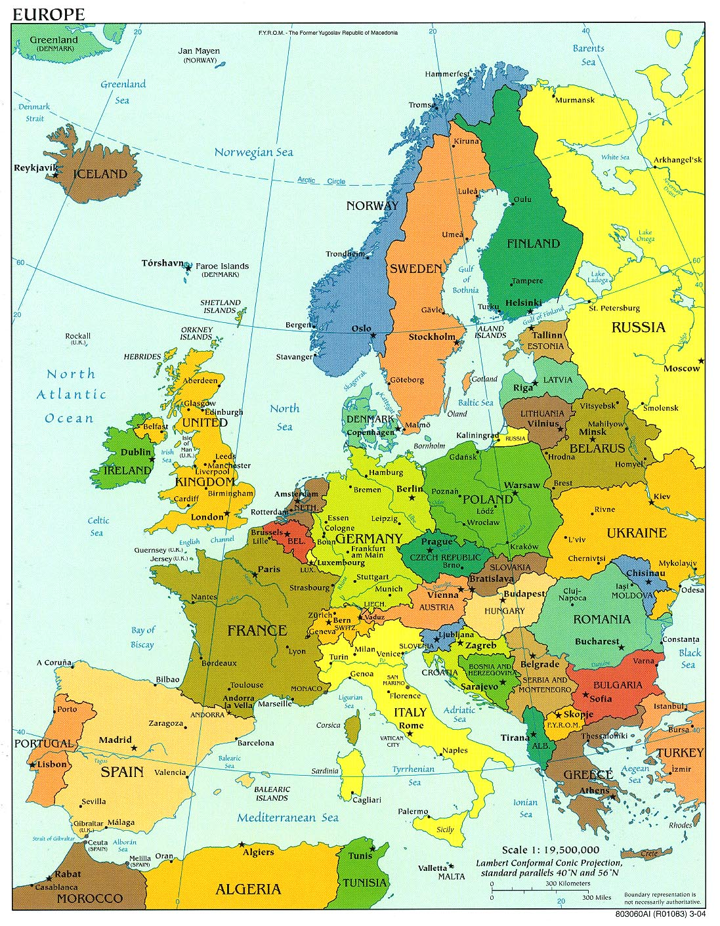
Causes of the Industrial Revolution
3. Governments, especially after political revolutions, created laws that encouraged industrialization and trade.

Slide 9
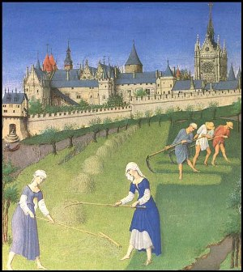
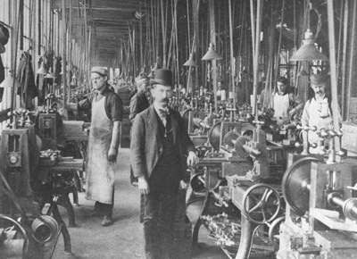
Discussion Question
Before 1750, a person’s wealth depended on how much land they owned. How did the Industrial Revolution change this?

Slide 10
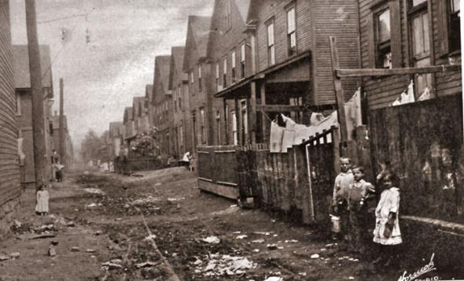
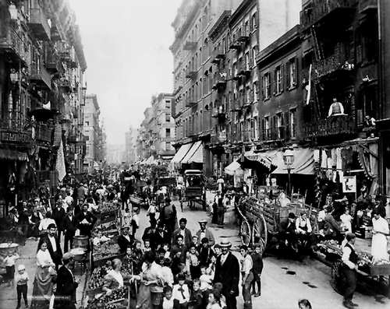
Effects of the Industrial Revolution
  Rapid urbanization
    Overcrowded cities
    Bad sanitation (health conditions)
    Crime rates

Slide 11
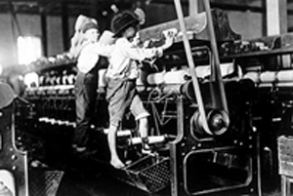
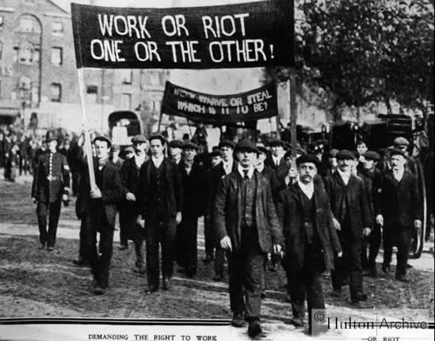
Effects of the Industrial Revolution
  2. Factories
  -Bad conditions for workers →Unions

Slide 12

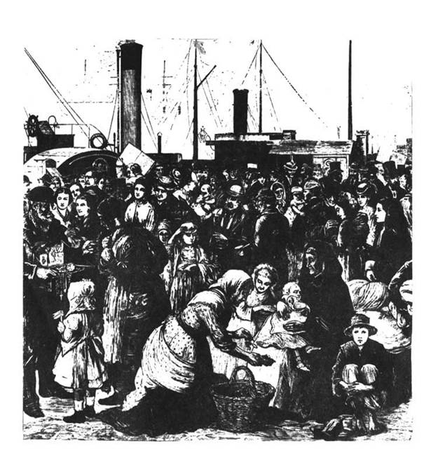
Effects of the Industrial Revolution
  3. Environmental Degradation (pollution)

Slide 13
what family members were working in a lower class family?
Dennis Rier of Newbury Port has this day engaged to come with his family to work in our factory on the following conditions. He is to be here about the 20th of next month [January 1815] and is to have the following wages per week:
  Himself $5.00
  His son Robert Rier, 10 years of age .83
  Daughter Mary, 12 years of age 1.25
  Son William, 13 years of age 1.50
  Son Michael, 16 years of age 2.00
10.58
Family labor force in the Slater factory, 1813
  List extracted from Time Books for 1813 in Cotton Mills, 1813-1816, Slater and Tiffany, Cotton, Slater Papers,
“I visited the corporate factory establishment at Waltham within a few miles of Boston. The establishment is for the spinning and weaving of cotton alone. Five hundred persons were employed at the time of my visit. The girls earn two, and sometimes three, dollars a week, be­sides their board. The little children earn one dollar a week. Most of the girls live in the houses provided by the corporation, which accommodate from six to eight each…Some have thus cleared off mort­gages from their fathers' farms; others have educated the hope of the family at college…”
  (Harriet Martineau, an English writer, visits shoe and cotton mills in New England, 1834)

Slide 14
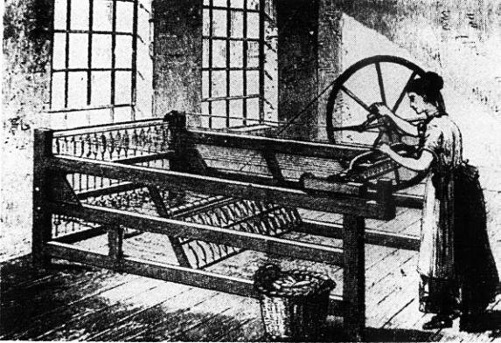
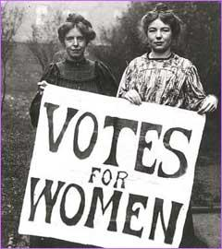
Effects of the Industrial Revolution
4. Feminist Movements

Slide 15
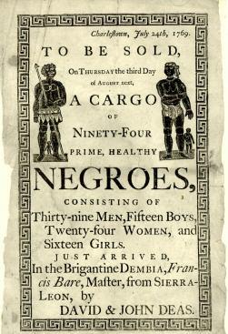
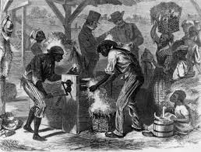
EFFECTS OF THE INDUSTRIAL REVOLUTION
5. The Slave Trade becomes more prevalent.

Slide 16
EFFECTS OF THE INDUSTRIAL REVOLUTION
6. International Economic Divisions (Lays the foundation for Imperialism

Slide 17
Independent writing
Which of the effects of the Industrial Revolution are the most important
You may choose two

Slide 18
K W L
Know | Want to Know | Learned

