Slide 1
The Cold War Unfolds
Chapter 15.1

Slide 2
Two Sides Face Off
Superpowers-US and USSR
NATO/Warsaw Pact
Iron Curtain-Winston Churchill describing the separation of Western and Eastern Europe
Berlin Wall

Slide 3
Eastern Europe resists USSR
1953 East Berlin 50, 000 workers protest
1956 Poland and Hungary want economic reform
Receive Soviet tanks
1968 Czechoslavakia protests “Prague Spring
Receive Soviet tanks

Slide 4
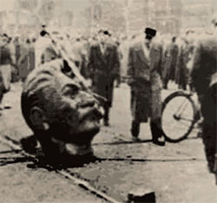

Slide 5
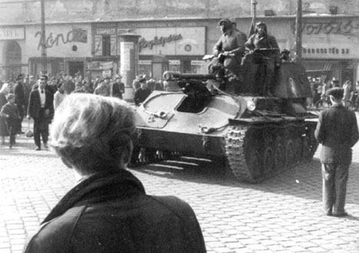

Slide 6
Nuclear Weapons and the World
Arms race
1949 Both have nuclear Weapons
1953 both have H-Bomb
Mutually assured destruction

Slide 7
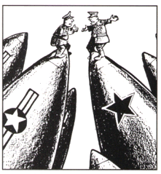

Slide 8
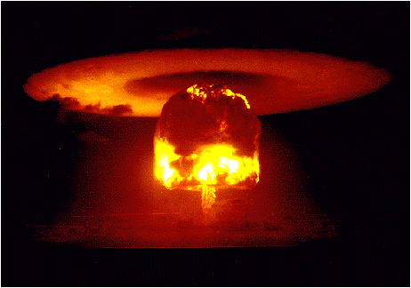

Slide 9
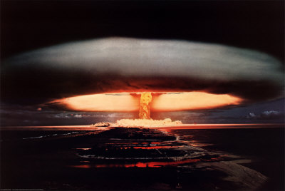

Slide 10
Limiting nukes
Disarmament talks
SALT 1 and 2
ABMs
START treaty
Détente limiting of tensions

Slide 11
NPT non-proliferation treaty

Slide 12
The Cold War Goes Global
US builds bases around the world
SEATO,CENTO, NATO alliances
Soviets and China-Soviet bloc

Slide 13
Cuban Missile Crisis
Castro-Cuba, Kennedy-US, Khrushchev-USSR
Soviets give missiles to Cuba
US demands missiles be taken out of communist Cuba
Khrushchev and Kennedy eye to eye
Khrushchev blinks

Slide 14
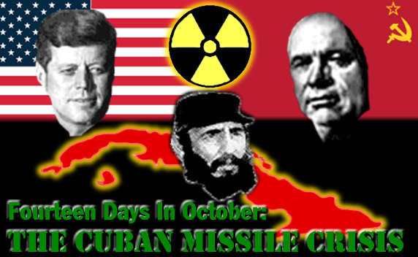

Slide 15
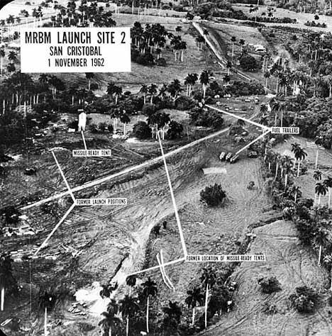

Slide 16
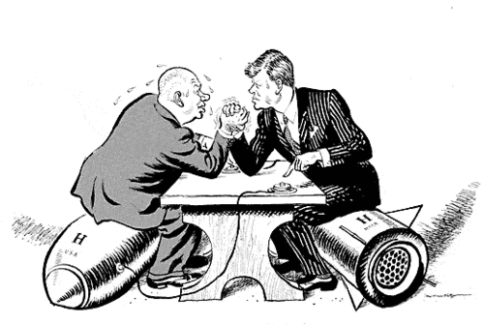

Slide 17
The Soviet Union in the Cold War
Communism-Command Economy
Value obedience to state and discipline
Limited rights and opportunities
Khrushchev-leader
Sakharov and Solzhenitsyn-dissidents

Slide 18
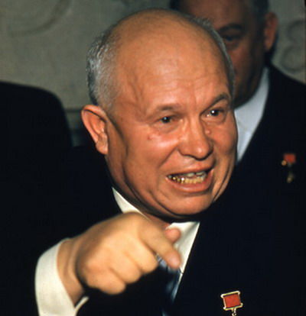

Slide 19
The U.S. in the Cold War
Democracy, capitalism, free markets, private property, consumerism, competition
Fear of communism
Mccarthy
HUAC
Blacklisting

Slide 20
